Slide 1
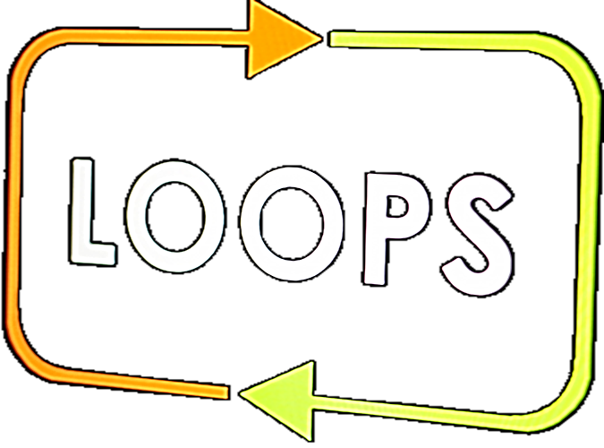
Conditional Iterative Statement (loop)
For-loop
SoftUni
Training Team
Software University
https://softuni.bg

Slide 2
Table of Contents
For-Loop
For-Loop Usage
Manipulating Text
2

Slide 3

Recap
Complex Conditional Statements

Slide 4
Recap
What is the output of the following example:
printf("%d", (!(5 == 5) && (4 + 1 == 5)));
(1)true
(0)false
Runtime error
Compile time error
4

Slide 5
Recap
What is the output of the following example:
printf("%d", (!(5 == 5) && (4 + 1 == 5)));
(1)true
(0)false
Runtime error
Compile time error
5

Slide 6
Recap
What is the output of the following example:
printf("%d", (!(3 == 3) || (3 == 5)));
Runtime error
(0)false
(1)true
Compile time error
6

Slide 7
Recap
What is the output of the following example:
printf("%d", (!(3 == 3) || (3 == 5)));
Runtime error
(0)false
(1)true
Compile time error
7

Slide 8
Recap
What is the output of the following example:
printf("%d", (!(3 > 5) || (1 == 1)));
Runtime error
Compile time error
(1)true
(0)false
8

Slide 9
Recap
What is the output of the following example:
printf("%d", (!(3 > 5) || (1 == 1)));
Runtime error
Compile time error
(1)true
(0)false
9

Slide 10
Recap
What is the output of the following example:
Less than 101
int number = 101;
if (number >= 1)
printf("Larger than 1\n");
if (number <= 101)
printf("Less than 101\n");
printf("Equal to 101\n");
Larger than 1
Equal to 101
Compile time error
10

Slide 11
Recap
What is the output of the following example:
Less than 101
int number = 101;
if (number >= 1)
printf("Larger than 1\n");
if (number <= 101)
printf("Less than 101\n");
printf("Equal to 101\n");
Larger than 1
Equal to 101
Compile time error
11

Slide 12
Recap
What is the output of the following example:
Runtime error
const char* role = "Administrator";
const char* password = "SoftUni";
if(strcmp(role, "Administrator") == 0) {
if(strcmp(password, "SoftUni") == 0) {
printf("Welcome!\n");
}
}
"Welcome!"
Compile time error
No output
12

Slide 13
Recap
What is the output of the following example:
Runtime error
const char* role = "Administrator";
const char* password = "SoftUni";
if(strcmp(role, "Administrator") == 0) {
if(strcmp(password, "SoftUni") == 0) {
printf("Welcome!\n");
}
}
"Welcome!"
Compile time error
No output
13

Slide 14
Recap
What is the output of the following example:
Runtime error
const char* role = "Administrator";
const char* password = "SoftUni";
if(strcmp(role, "SoftUni") == 0) {
if(strcmp(password, "SoftUni") == 0) {
printf("Welcome!\n");
}
}
"Welcome!"
Compile time error
No output
14

Slide 15
Recap
What is the output of the following example:
Runtime error
const char* role = "Administrator";
const char* password = "SoftUni";
if(strcmp(role, "SoftUni") == 0) {
if(strcmp(password, "SoftUni") == 0) {
printf("Welcome!\n");
}
}
"Welcome!"
Compile time error
No output
15

Slide 16

Conditional Iterative Statement
For-loop

Slide 17
For-loop
Used to check for certain conditions and then repeatedly execute a block of code as long as those conditions are met.
Keyword
Variable (counter)
Condition
for (int i = 1; i <= 10; i++) {
printf("%d\n", i);
}
Ensure each iteration has a unique counter value
Code block

Slide 18

Numbers from 1 to 100
Print the numbers from 1 to 100:
Each number should be on a new line
i = 1
i <= 100
End loop
Print i

Slide 19
Latin Letters
Print the lowercase letters:
In order from a to z:
i = 'a'
false
i <= 'z'
End loop
true
Print i

Slide 20
Sum Numbers
Write a program that:
Reads count of numbers n
n times read a number
Print the sum of all the numbers
Examples:
4
45
-20
7
11
2
10
20
3
-10
-20
-30
30
-60
43

Slide 21
Read input
i = 1
sum = 0
false
i <= n
Print the sum
true
Read a number;
Add it to the sum
Принтиране на сумата
21

Slide 22
Number Sequence
Write a program that:
Reads n numbers
Prints the maximum and the minimum numbers
5
10
20
304
0
50
Max number: 304
Min number: 0

Slide 23



Number Sequence
int min = INT_MAX;
int max = INT_MIN;
int n;
scanf("%d", &n);
for (int i = 0; i < n; i++) {
int num;
scanf("%d", &num);
if (num < min) min = num;
if (num > max) max = num;
}
printf("Max number: %d\nMin number: %d", max, min);

Slide 24
smallest = INT_MAX
biggest = INT_MIN
Read n
i = 0
false
i < n
Print output
true
biggest = num
num > biggest
Read input
smallest = num
num < smaller
24

Slide 25
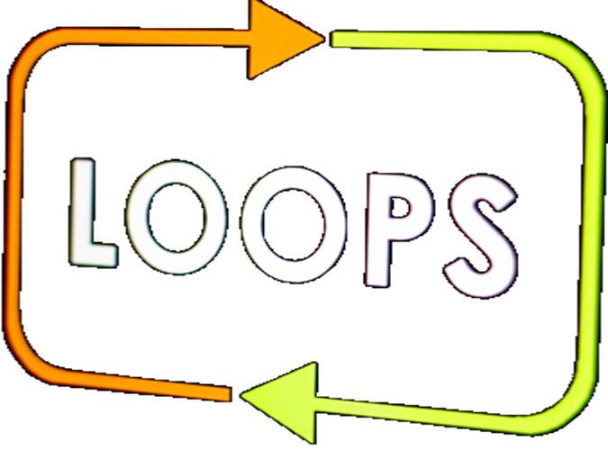
Conditional Iterative Statement
Live Demo

Slide 26
Left and Right Sum
Write a program that:
Read number n
Reads 2*n numbers
Check if the sum of the left n and the right n numbers are equal
If they are equal print "Yes" and the sum, otherwise "No" and the difference as a positive number

Slide 27
Left and Right Sum
int n; scanf("%d", &n);
int left_sum = 0;
for(int i = 1; i <= n; i++) {
int current_num; scanf("%d", &current_num);
left_sum = left_sum + current_num;
}
// TODO: read and calculate the rightSum
if(left_sum == right_sum) {
printf("Yes, sum = %d\n", left_sum);
} else {
printf("No, diff = %d\n", abs(right_sum - left_sum));
}

Slide 28

Manipulating Text

Slide 29
Manipulating Text
You can call a function that returns the length of a text
You can get a single character at a specific index
char str[20]; scanf("%s", str); // SoftUni
int length = strlen(str); // 7
char str[20]; scanf("%s", str); // SoftUni
char letter = str[4]; // U

Slide 30
Vowels Sum
Write a program that:
Reads text
Print the sum of the vowels according the table below:
Examples:
a | e | i | o | u
1 | 2 | 3 | 4 | 5
hello
6
(e+o = 2+4 = 6)
hi
3
(i = 3)
bamboo
9
(a+o+o = 1+4+4 = 9)
beer
4
(e+e = 2+2 = 4)

Slide 31
Vowels Sum
char input[30]; scanf("%s", input);
int sum = 0;
for (int i = 0; i < strlen(input); i++) {
switch (input[i]) {
case 'a': sum += 1; break;
case 'e': sum += 2; break;
// TODO: Add cases for the other vowels.
}
}
printf("Vowels sum = %d\n", sum);
Get the length of the text
Accesses single character

Slide 32

Exercise For-loop
Live Demo

Slide 33

Summary
…
…
…
Usage of for-loop
Read n count of input data
Manipulating text

Slide 34
Questions?
Notes:
34

Slide 35












SoftUni Diamond Partners

Slide 36




SoftUni Organizational Partners

Slide 37
Trainings @ Software University (SoftUni)
Software University – High-Quality Education, Profession and Job for Software Developers
softuni.bg, softuni.org
Software University Foundation
softuni.foundation
Software University @ Facebook
facebook.com/SoftwareUniversity
Software University Forums
forum.softuni.bg
37
Notes:
37

Slide 38

License
This course (slides, examples, demos, exercises, homework, documents, videos and other assets) is copyrighted content
Unauthorized copy, reproduction or use is illegal
© SoftUni – https://softuni.org
© Software University – https://softuni.bg
Notes:
38

